Slide 1


RARP PROTOCOL And RIP PROTOCOL
By, GOVARDAN - September 24 2023

Slide 2


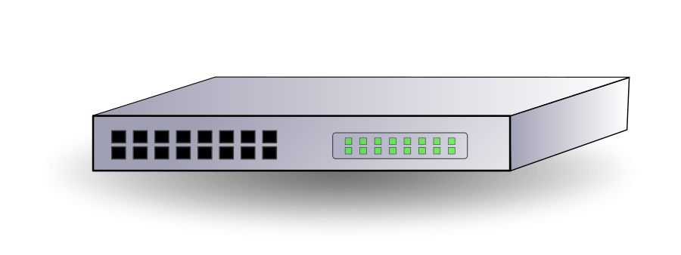
Network Setup
CAM
PORT | MAC ADDRESS
1 | AA:AA:AA:AA:AAAA
2 | BB:BB:BB:BB:BB:BB
3 | CC:CC:CC:CC:CC:CC
4 | AA:AA:AA:AA:AA:AA
GUHAN
192.168.04.5
AA:AA:AA:AA:AAAA
BOOBATHI
192.168.04.15
CC:CC:CC:CC:CC:CC
NETWORK ID : 192.168.04.0
ARUMUGAM
192.168.04.10
BB:BB:BB:BB:BB:BB
DURAI MURUGAN
192.168.04.20
AA:AA:AA:AA:AA:AA

Slide 3




நாம எவ்வளவு தான் விரட்டி விரட்டி அடித்தாலும். மறுபடியும் பாசமா நம்ம கிட்டயே திரும்பி வர ஒரே ஜீவன் கொசு மட்டுமே...!
IP ADDRESS
MAC ADDRESS
Arp
Request = Tell me your MAC address (192.168.04.10)
Response = MAC address

Slide 4
CAM
PORT | MAC ADDRESS
1 | AA:AA:AA:AA:AAAA
2 | BB:BB:BB:BB:BB:BB
3 | CC:CC:CC:CC:CC:CC
4 | AA:AA:AA:AA:AA:AA
GUHAN
192.168.04.5
AA:AA:AA:AA:AAAA
BOOBATHI
192.168.04.15
CC:CC:CC:CC:CC:CC
NETWORK ID : 192.168.04.0
ARP REQUEST
Request Mac Address of
192.168.10.05
ARUMUGAM
192.168.04.10
BB:BB:BB:BB:BB:BB
IP ADDRESS | MAC ADDRESS
DURAI MURUGAN
192.168.04.20
AA:AA:AA:AA:AA:AA
ARP CACHE

Slide 5
ARP RESPONSE
My Mac Address is
AA:AA:AA:AA:AAAA
GUHAN
192.168.04.05
AA:AA:AA:AA:AAAA
BOOBATHI
192.168.04.15
CC:CC:CC:CC:CC:CC
NETWORK ID : 192.168.04.0
ARUMUGAM
192.168.04.10
BB:BB:BB:BB:BB:BB
DURAI MURUGAN
192.168.04.20
AA:AA:AA:AA:AA:AA
IP ADDRESS | MAC ADDRESS
192.168.04.05 | AA:AA:AA:AA:AAAA
DURAI MURUGAN
192.168.04.20
AA:AA:AA:AA:AA:AA

Slide 6
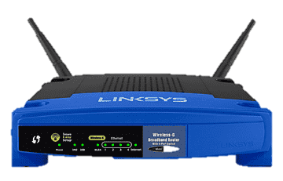
ARP REQUEST
Request Mac Address of
192.168.05.10
NETWORK ID : 192.168.04.0
NETWORK ID : 192.168.05.0
ARP REQUEST
Request Mac Address of
192.168.05.0
ARP RESPONSE
My Mac Address is
AA:AA:AA:AA:AAAA
ARUMUGAM
192.168.04.20
BB:BB:BB:BB:BB:BB
DURAI MURUGAN
192.168.04.10
AA:AA:AA:AA:AA:AA
BOOBATHI
192.168.05.10
CC:CC:CC:CC:CC:CC
GUHAN
192.168.05.20
AA:AA:AA:AA:AAAA

Slide 7

Dynamic Routing Protocols
RIP (Routing Information Protocol)
OSPF (Open Shortest Path First)
EIGRP (Enhanced Interior Gateway Routing Protocol)

Slide 8

Routing Information Protocol (RIP) (or) Dynamic Vector Routing
Version 1
Version 2

Slide 9

Route 1
3 Hobs
1st Interface
2 Hobs
GOVARDAN
GUHAN
2nd Interface
Route 2
3rd Interface
4 Hobs
Route 3

Slide 10
HOW RIP WORKS
192.186.1.1
CC:CC:CC:CC:CC:CC
192.186.3.1
MM:MM:MM:MM:MM:MM
192.186.2.1
FF:FF:FF:FF:FF:FF
192.186.2.2
HH:HH:HH:HH:HH:HH
192.168.2.5
AA:AA:AA:AA:AA:AA
GOVARDAN
192.168.05.10
BB:BB:BB:BB:BB:BB
GUHAN
Network 2
Network 1
Network | Interface | Connection | Hob
192.186.1.0 | 1 | c | 0
192.186.2.0 | 2 | c | 0
Network | Interface | Connection | Hob
192.186.2.0 | 1 | c | 0
192.186.3.0 | 2 | c | 0
Network 3
Router 1 Routing Table
Sharing information
Router 2 Routing Table

Slide 11
HOW RIP WORKS
192.186.1.1
CC:CC:CC:CC:CC:CC
192.186.3.1
MM:MM:MM:MM:MM:MM
192.186.2.1
FF:FF:FF:FF:FF:FF
192.186.2.2
HH:HH:HH:HH:HH:HH
192.168.2.5
AA:AA:AA:AA:AA:AA
GOVARDAN
192.168.05.10
BB:BB:BB:BB:BB:BB
GUHAN
Network 2
Network 1
Network | Interface | Connection | Hob
192.186.1.0 | 1 | c | 0
192.186.2.0 | 2 | c | 0
192.186.3.0 | 2 | R | 1
Network | Interface | Connection | Hob
192.186.2.0 | 1 | c | 0
192.186.3.0 | 2 | c | 0
192.186.1.0 | 2 | R | 0
Network 3
Router 1 Routing Table
Sharing information
Router 2 Routing Table

Slide 12
RIP TIMERS
Update Timer = 30s
Invalid Timer = 180s
Flush Timer = 240s
192.186.1.1
CC:CC:CC:CC:CC:CC
192.186.3.1
MM:MM:MM:MM:MM:MM
192.186.2.1
FF:FF:FF:FF:FF:FF
192.186.2.2
HH:HH:HH:HH:HH:HH
192.168.2.5
AA:AA:AA:AA:AA:AA
GOVARDAN
192.168.05.10
BB:BB:BB:BB:BB:BB
GUHAN
Network 2
Network 1
Network | Interface | Connection | Hob
192.186.1.0 | 1 | c | 0
192.186.2.0 | 2 | c | 0
192.186.3.0 | 2 | R | 1
Network | Interface | Connection | Hob
192.186.2.0 | 1 | c | 0
192.186.3.0 | 2 | c | 0
192.186.1.0 | 2 | R | 0
Network 3
Router 1 Routing Table
Sharing information
Router 2 Routing Table

Slide 13
RIP TIMERS
Update Timer = 30s
Invalid Timer = 180s
Flush Timer = 240s
192.186.1.1
CC:CC:CC:CC:CC:CC
192.186.3.1
MM:MM:MM:MM:MM:MM
192.186.2.1
FF:FF:FF:FF:FF:FF
192.186.2.2
HH:HH:HH:HH:HH:HH
192.168.2.5
AA:AA:AA:AA:AA:AA
GOVARDAN
192.168.05.10
BB:BB:BB:BB:BB:BB
GUHAN
Network 2
Network 1
Network | Interface | Connection | Hob
192.186.2.0 | 2 | c | 0
192.186.3.0 | 2 | R | 1
Network | Interface | Connection | Hob
192.186.2.0 | 1 | c | 0
192.186.3.0 | 2 | c | 0
192.186.1.0 | 2 | R | 0
Network 3
Router 1 Routing Table
Sharing information
Router 2 Routing Table

Slide 14
RIP TIMERS
Update Timer = 30s
Invalid Timer = 180s
Flush Timer = 240s
192.186.1.1
CC:CC:CC:CC:CC:CC
192.186.3.1
MM:MM:MM:MM:MM:MM
192.186.2.1
FF:FF:FF:FF:FF:FF
192.186.2.2
HH:HH:HH:HH:HH:HH
192.168.2.5
AA:AA:AA:AA:AA:AA
GOVARDAN
192.168.05.10
BB:BB:BB:BB:BB:BB
GUHAN
Network 2
Network 1
Network | Interface | Connection | Hob
192.186.2.0 | 2 | c | 0
192.186.3.0 | 2 | R | 1
Network | Interface | Connection | Hob
192.186.2.0 | 1 | c | 0
192.186.3.0 | 2 | c | 0
Network 3
ENTRY DELETED
Time out
Router 1 Routing Table
Sharing information
Router 2 Routing Table

Slide 15
Load Balancing
Route 1
Route 1 (Hob Count = 3)
Route 2(Hob Count = 3)
Route 2
Note : Maximum Hob Count Will Be 15

Slide 16


ANY QUESTIONS ?

Slide 17

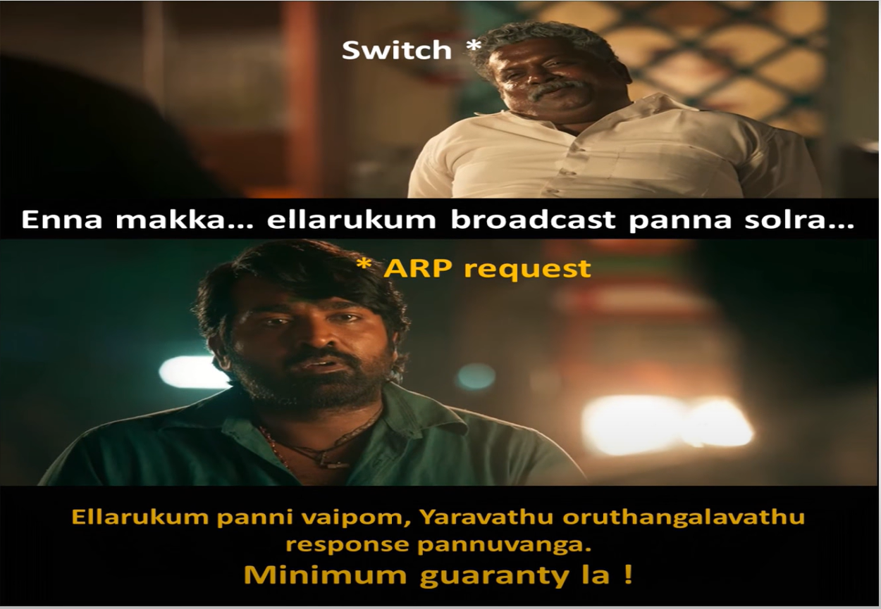
Meme

Slide 18


